Slide 1
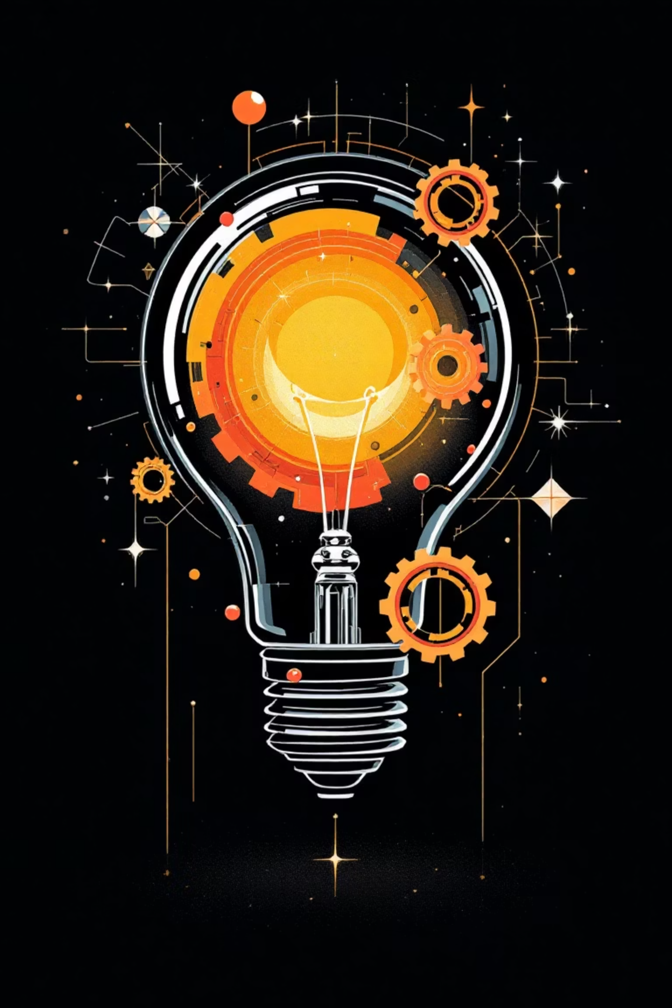
Copyrights and Patents: Protecting Creativity and Innovation
Discover how intellectual property rights safeguard the fruits of human ingenuity, from groundbreaking inventions to artistic masterpieces. This presentation explores the essential frameworks that protect creators and drive progress in our modern world.

Slide 2
What is Intellectual Property?
Intellectual Property (IP) refers to creations of the mind—encompassing inventions, literary and artistic works, designs, symbols, names, and images. These intangible assets form the backbone of modern innovation and creative industries.
Copyrights
Protect original works of authorship including literature, music, films, and artistic expressions
IP rights grant creators the legal authority to control and benefit financially from their creations, establishing a vital bridge between innovation and economic reward. This protection fosters an environment where creativity thrives and inventors can safely share their breakthroughs with the world.
Patents
Safeguard inventions and novel technological solutions that advance human capability

Slide 3
Understanding Copyrights
Copyright protection extends to original works fixed in a tangible medium of expression. This includes books, music, films, software, photographs, and artistic creations. The moment a creator puts pen to paper, brush to canvas, or fingers to keyboard, their work gains automatic copyright protection.
Exclusive Rights Granted
Duration of Protection
Automatic Protection
Copyright lasts for the life of the author plus 70 years. For works made for hire, corporate authorship, or anonymous works, protection extends for 95 years from publication or 120 years from creation, whichever is shorter.
Copyright is secured automatically upon creation and fixation. Whilst registration isn't required for protection, it provides crucial benefits for legal enforcement and establishes a public record of the copyright claim.
Reproduction of the work
Distribution to the public
Public performance and display
Creation of derivative works

Slide 4

What Can Be Copyrighted?
Copyright protection spans an impressive breadth of creative expression. Any original work that demonstrates a modicum of creativity and exists in a fixed, tangible form qualifies for protection under copyright law.
Literary Works
Artistic Works
Musical Compositions
Digital Creations
Novels, poems, articles, essays, and written content of all forms
Paintings, sculptures, photographs, and visual art creations
Software code, digital artwork, and architectural designs
Original songs, scores, recordings, and musical arrangements
Iconic Example: Michael Jackson's legendary album "Thriller" enjoys comprehensive copyright protection covering the musical compositions, album artwork, and groundbreaking music videos—demonstrating how a single creative project can encompass multiple layers of copyright protection.

Slide 5
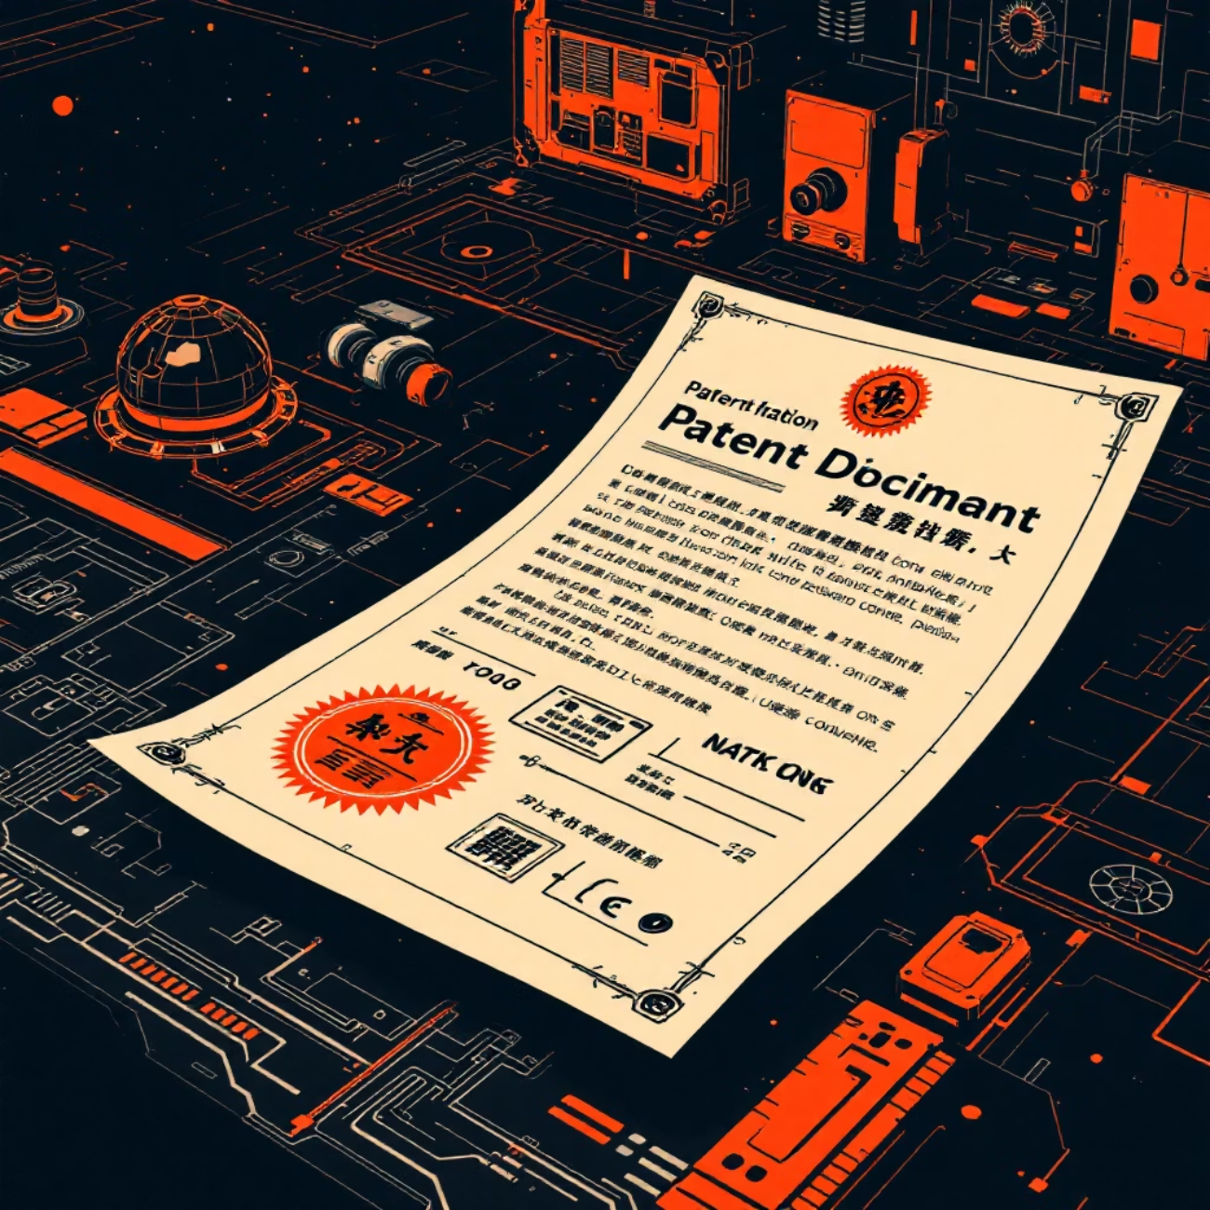
What is a Patent?
A patent represents a government-granted exclusive right awarded to an inventor for a new and useful invention. This powerful legal instrument provides inventors with a temporary monopoly, allowing them to commercialise their innovations without fear of immediate competition.
Patents cover a wide spectrum of inventions: products, processes, machines, compositions of matter, or significant improvements to existing technologies. In exchange for this exclusive right, inventors must provide a detailed public disclosure of their invention, contributing to the collective pool of human knowledge.
20-Year Exclusive Rights
The right to exclude others from making, using, selling, or importing the invention
Public Disclosure Required
Inventors must reveal their invention's workings to advance collective knowledge

Slide 6



Types of Patents
Patent law recognises three distinct categories of patents, each designed to protect different aspects of innovation. Understanding these classifications helps inventors choose the appropriate protection for their creations.
Utility Patents
Design Patents
Plant Patents
The most common type, protecting functional inventions including new machinery, chemical processes, manufacturing methods, and technological innovations. These patents grant 20 years of protection from the filing date.
Safeguard the ornamental design and aesthetic appearance of manufactured items. Protection lasts for 14-15 years, focusing purely on how a product looks rather than how it functions.
Protect new and distinct varieties of asexually reproduced plants. This unique category encourages agricultural innovation and the development of improved plant species.
New plant varieties
Product appearance
Hybrid species
New processes and machines
Decorative features
Cultivated strains
Chemical compositions
Visual characteristics
Technological improvements
Remarkable Achievement: Gurtej Singh Sandhu, a pioneering electrical engineer, holds over 1,340 utility patents—one of the most prolific inventors in U.S. history. His work in semiconductor technology has revolutionised computer memory systems worldwide.

Slide 7

Patentability Criteria
Not every invention qualifies for patent protection. To receive a patent, an invention must satisfy stringent criteria designed to ensure that only truly innovative and beneficial creations receive exclusive rights. These requirements maintain the integrity of the patent system whilst encouraging genuine advancement.
01
02
Utility
Novelty
The invention must be useful and provide some identifiable benefit or solve a specific problem
The invention must be completely new and not previously known, used, or published anywhere in the world
03
04
Non-Obviousness
Statutory Categories
The invention cannot be an obvious improvement to someone with ordinary skill in the relevant field
Must fall into accepted categories: process, machine, manufacture, composition of matter, or improvement thereof
Territorial Nature: Patent protection is territorial, meaning a patent is only valid in the country or region where it was granted. Inventors seeking global protection must file applications in multiple jurisdictions, though international treaties can streamline this process.

Slide 8

Historical Evolution and Importance
The concept of protecting intellectual property has deep historical roots. Venice enacted the world's first patent law in 1474, granting artisans monopoly rights over their inventions for a specified period. This groundbreaking legislation recognised that innovation flourishes when creators can reap rewards from their ingenuity.
The United States Constitution embedded intellectual property protection into the nation's foundational framework. Article 1, Section 8 empowers Congress to grant patents and copyrights "to promote the Progress of Science and useful Arts." This constitutional mandate reflects the Founders' understanding that protecting IP rights serves the greater public good.
1474
1790
Venice establishes first patent law
First U.S. Patent Act enacted
1
2
3
4
1787
Today
U.S. Constitution includes IP Clause
Global IP framework drives innovation
Strategic Protection: Coca-Cola famously chose to protect its formula as a trade secret rather than patenting it. Whilst patents expire after 20 years, trade secrets can last indefinitely—provided they remain confidential. This strategic decision has kept the formula secret for over 130 years.

Slide 9
Legal Rights and Enforcement
Intellectual property rights are only as strong as their enforcement mechanisms. Both copyright and patent holders possess powerful legal tools to protect their creations and prevent unauthorised use. Understanding these rights empowers creators to defend their work whilst respecting others' intellectual property.
Copyright Enforcement
Patent Litigation
Copyright owners can initiate legal action against infringers to halt unauthorised copying, distribution, or performance of their work. Remedies include injunctions, monetary damages, and in severe cases, criminal penalties. The Digital Millennium Copyright Act provides additional protections for online content.
Patent holders can sue to prevent others from exploiting their invention without permission. Patent litigation can result in substantial damages, especially for wilful infringement. Courts may award treble damages and attorney's fees in cases of intentional violation.
Licensing and Transfer
Public Knowledge Benefits
Both patents and copyrights represent valuable assets that can be licensed or sold. Licensing allows others to use IP whilst the owner retains ownership. Transfers convey full rights to a new owner. These mechanisms create markets for innovation and creative works.
Patent applications are published 18 months after filing, making technical information publicly available. Once protection expires, inventions enter the public domain, enabling others to build upon previous innovations. This balance promotes both private incentives and collective progress.

Slide 10
Why Copyrights and Patents Matter
Intellectual property rights form the bedrock of our innovation economy and cultural landscape. They create a delicate but essential balance between protecting individual creators and enriching the public domain. Understanding these rights isn't merely academic—it's fundamental to participating in today's knowledge-based society.
Incentivising Innovation
Economic Growth
Patents and copyrights encourage investment in new ideas, technologies, and artistic works by ensuring creators can profit from their efforts. Without this protection, the incentive to innovate diminishes significantly.
IP-intensive industries contribute trillions to global economies and employ millions worldwide. Strong IP protection attracts investment, fosters entrepreneurship, and drives technological advancement.
Cultural Enrichment
Knowledge Sharing
Copyright protection enables artists, writers, and musicians to earn livelihoods from their creative work, enriching our cultural landscape with diverse voices and perspectives.
The requirement to publicly disclose patented inventions accelerates technological progress by building a shared foundation of knowledge that future innovators can reference and improve upon.
Protect Your Ideas—Innovate and Create with Confidence!
Whether you're an inventor, artist, entrepreneur, or simply a curious citizen, understanding intellectual property rights empowers you to contribute to and benefit from our collective creativity. Embrace these protections, respect others' rights, and let your imagination soar.

